Slide 1
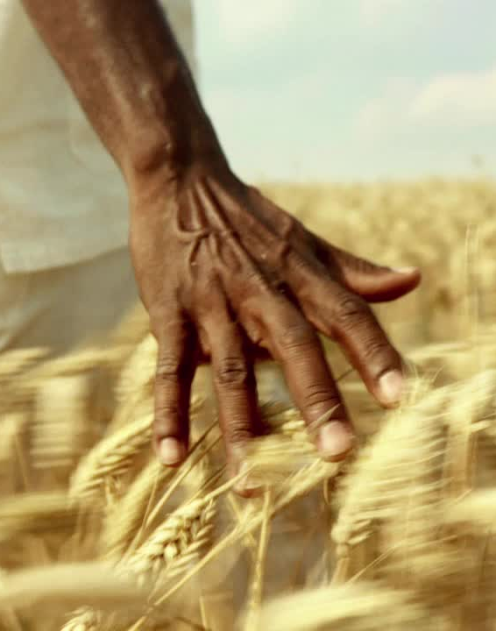
India’s Crop Production Data Analysis
Kunal More
Notes:
Good Afternoon, Today I am presenting my analysis on India’s Crop Production. India is an agricultural country. Approx 60% of the population work in this industry directly or indirectly. Which helps to contribute about 18% of total GDP. While doing this analysis the first question in mind my was is India producing enough to feed its population?

Slide 2

# Indian Crop Production: EDA to chart Agriculture highlights using Python
The Agriculture business domain, as a vital part of the overall supply chain, is
expected to highly evolve in the upcoming years via the developments, which are
taking place on the side of the Future Internet. This paper presents a novel
Business-to-Business collaboration platform from the agri-food sector perspective,
which aims to facilitate the collaboration of numerous stakeholders belonging to
associated business domains, in an effective and flexible manner.
This dataset provides a huge amount of information on crop production in India
ranging from several years. Based on the Information the ultimate goal would be to
predict crop production and find important insights highlighting key indicators and
metrics that influence crop production.
Make views and dashboards first and also make a story out of it.
Notes:
This graph represents crops highly produced from 1997-2019. Sugarcane, Rice, Wheat cotton and maize are the most produced ones. Among these crops wheat is grown in winter and others are grown in monsoon. Until 2019 crops like rice and wheat were produced about more than 1.9B tonnes.

Slide 3
Visualization on Important variables:
Notes:
This graph represents crops highly produced from 1997-2019. Sugarcane, Rice, Wheat cotton and maize are the most produced ones. Among these crops wheat is grown in winter and others are grown in monsoon. Until 2019 crops like rice and wheat were produced about more than 1.9B tonnes.

Slide 4
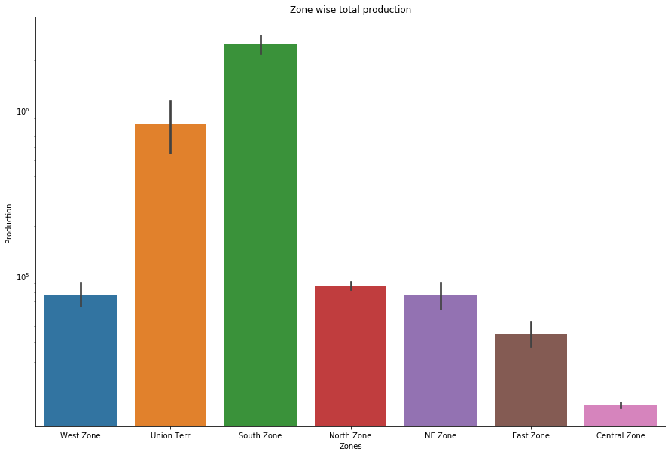
Zonal distribution of crops

Slide 5
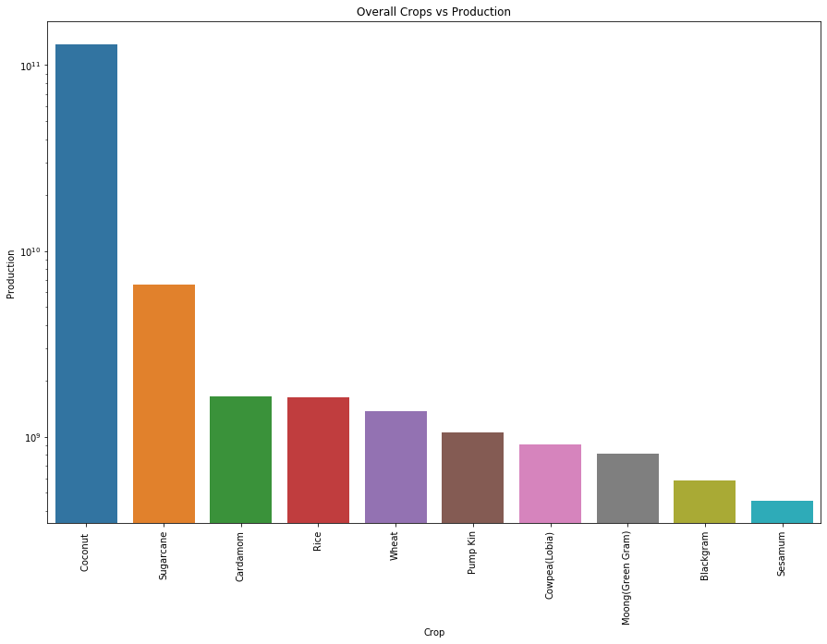
Crop wise Production status:
Notes:
This graph represents crops highly produced from 1997-2019. Sugarcane, Rice, Wheat cotton and maize are the most produced ones. Among these crops wheat is grown in winter and others are grown in monsoon. Until 2019 crops like rice and wheat were produced about more than 1.9B tonnes.

Slide 6
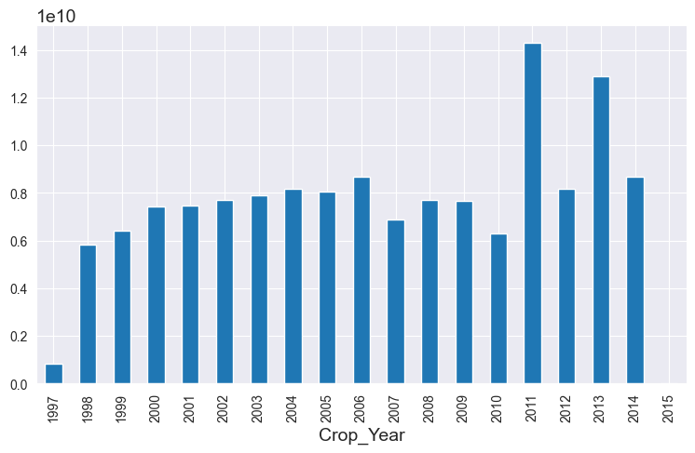
Yearwise Production Status:
Notes:
This graph represents crops highly produced from 1997-2019. Sugarcane, Rice, Wheat cotton and maize are the most produced ones. Among these crops wheat is grown in winter and others are grown in monsoon. Until 2019 crops like rice and wheat were produced about more than 1.9B tonnes.

Slide 7
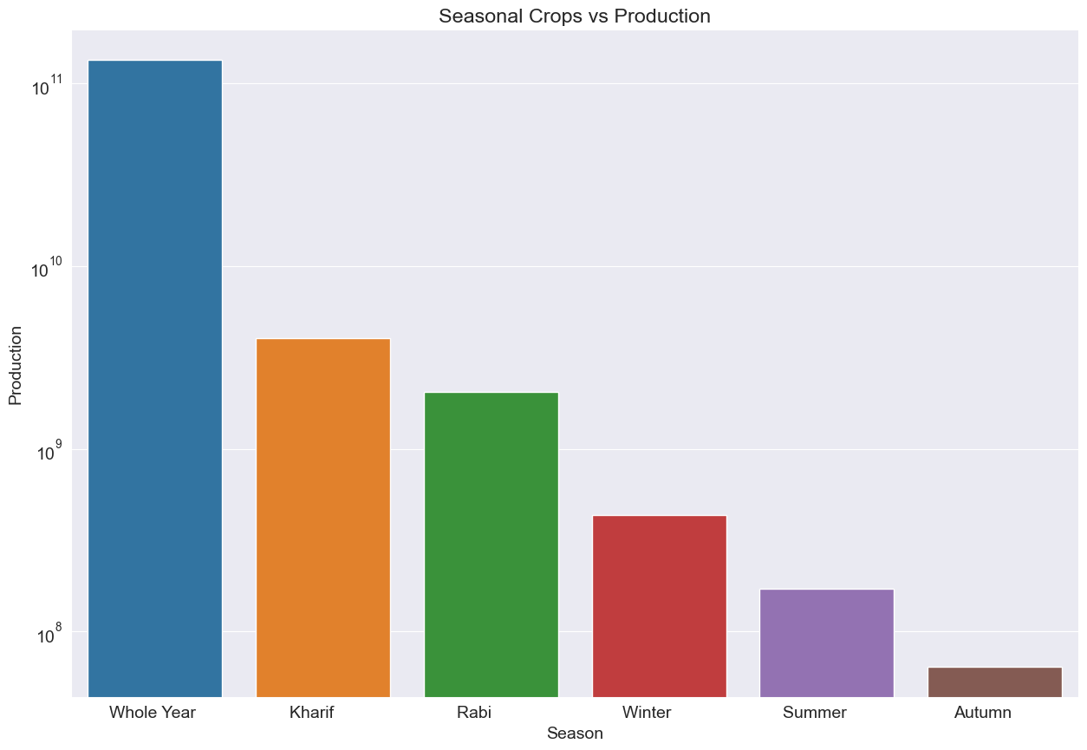
Season wise Production Status:
Notes:
This graph represents crops highly produced from 1997-2019. Sugarcane, Rice, Wheat cotton and maize are the most produced ones. Among these crops wheat is grown in winter and others are grown in monsoon. Until 2019 crops like rice and wheat were produced about more than 1.9B tonnes.

Slide 8
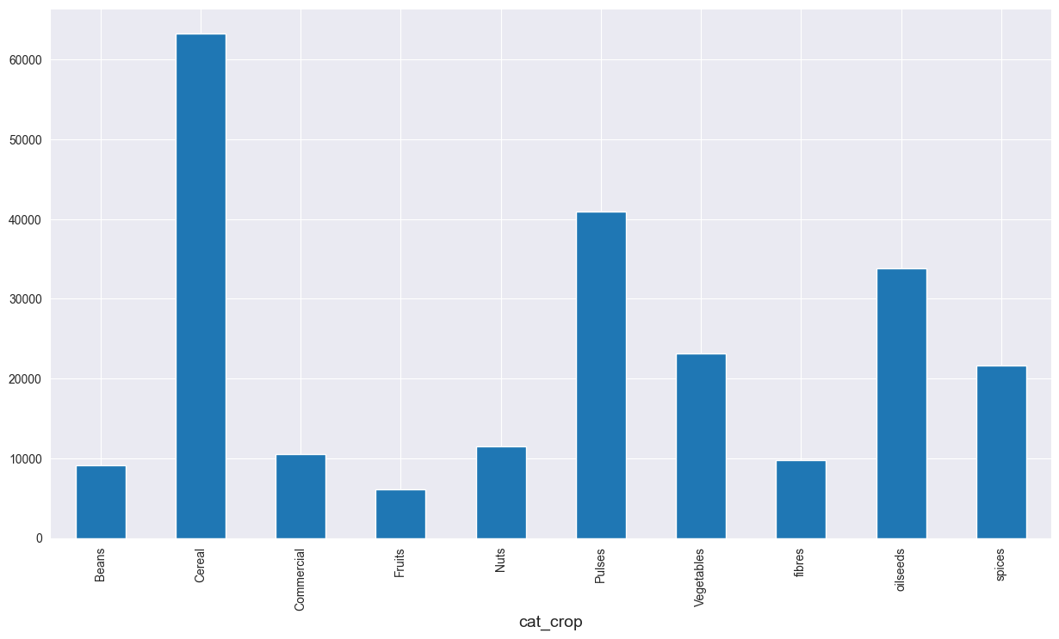
Crop wise Production plot describing production values for all crop types.
Notes:
This graph represents crops highly produced from 1997-2019. Sugarcane, Rice, Wheat cotton and maize are the most produced ones. Among these crops wheat is grown in winter and others are grown in monsoon. Until 2019 crops like rice and wheat were produced about more than 1.9B tonnes.

Slide 9
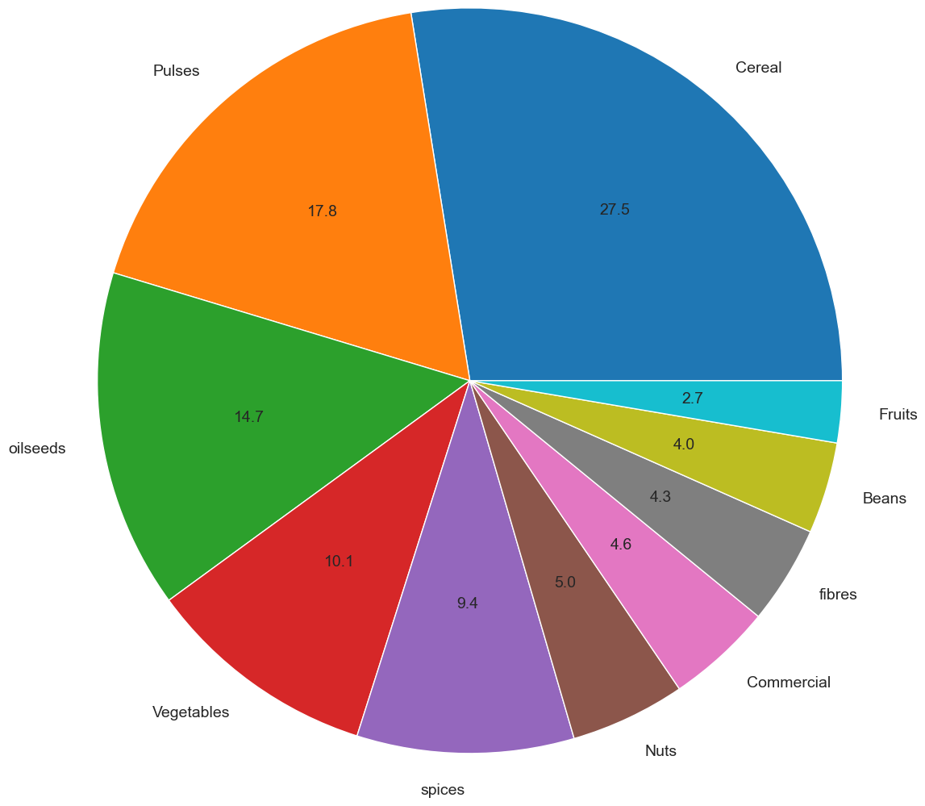
Different proportion of Crop Categories for India:
Notes:
This graph represents crops highly produced from 1997-2019. Sugarcane, Rice, Wheat cotton and maize are the most produced ones. Among these crops wheat is grown in winter and others are grown in monsoon. Until 2019 crops like rice and wheat were produced about more than 1.9B tonnes.

Slide 10
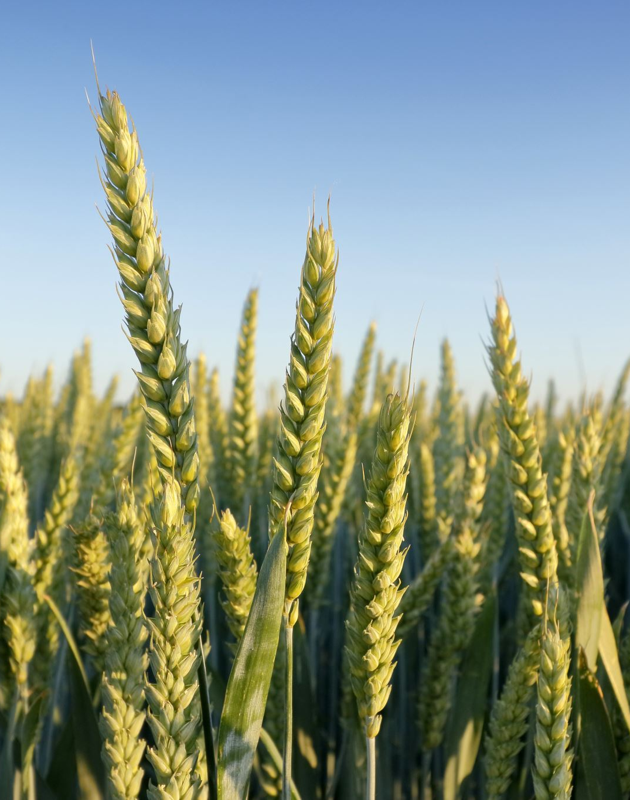
Result
1. Rice is grown heavily when we look the frequency of crops in India
2. Rice needs Winter for it mature
3. Statewise Punjab dominates in rice production
4. District wise its BARDHAMAN(2.13%), MEDINIPUR WEST(1.8%) and WEST GODAVARI(1.73%) which contributes to total rice production.
5. Yearwise 2014 is the year when production reached the peak production
6. Correlation between Area and Production shows high production is directly proportional to Area under cultivation.
Notes:
This graph represents crops highly produced from 1997-2019. Sugarcane, Rice, Wheat cotton and maize are the most produced ones. Among these crops wheat is grown in winter and others are grown in monsoon. Until 2019 crops like rice and wheat were produced about more than 1.9B tonnes.

Slide 11
1. Top cultivating states based on the Cultivation area are: Uttar Pradesh(4.33e+08), Madhya Pradesh(3.29e+08) and Maharashtra(3.22e+08)
2. Yearwise Statues of these States:
a. Uttar Pradesh: High Production was seen in 2005 and after that it's been reducing gradually.
b. Madhya Pradesh:1998 showed a high production and then there was gradual reduction but it picked up and 2012 also showed a peak in Production
c. Maharashtra:Production went down drastically in 2006 and again the levels went up and hit a high peak after 2007
d. Rajasthan: the production hit a all time low in the year 2002 and then picked up by 2010
e. West Bengal:the production hit a peak around 2006 but it has hit a low after 2007 and never recovered back.
Result
Notes:
This graph represents crops highly produced from 1997-2019. Sugarcane, Rice, Wheat cotton and maize are the most produced ones. Among these crops wheat is grown in winter and others are grown in monsoon. Until 2019 crops like rice and wheat were produced about more than 1.9B tonnes.

Slide 12
Result
1. Production wise top states of North zone are:
* Punjab(5.86e+08)
* Uttar Pradesh(3.23e+09), and
* Haryana(3.81e+08)
2. Top crops of these states are:
* Sugarcane,
* Wheat and
* Rice
Notes:
This graph represents crops highly produced from 1997-2019. Sugarcane, Rice, Wheat cotton and maize are the most produced ones. Among these crops wheat is grown in winter and others are grown in monsoon. Until 2019 crops like rice and wheat were produced about more than 1.9B tonnes.

Slide 13
Result
1. Coconut cultivation is yearlong and doesn't get restricted to any particular seasons
2. Top states involved in coconut production are: Kerala, Andhra Pradesh and Tamil Nadu
3. Top districts featuring in coconut production is KOZHIKODE(11.75%), MALAPPURAM(11.16%) and THIRUVANANTHAPURAM(7.7%)
4. Yearwise coconut cultivation is strong and its increasing healthly
5. High coconut cultivation is directly proportional to area under cultivation.
Notes:
This graph represents crops highly produced from 1997-2019. Sugarcane, Rice, Wheat cotton and maize are the most produced ones. Among these crops wheat is grown in winter and others are grown in monsoon. Until 2019 crops like rice and wheat were produced about more than 1.9B tonnes.

Slide 14
References and Future Work
Future Work:
This analysis is just the beginning, and with nineteen years of crop production data, there are numerous possibilities for further exploration:
1. Imputation for Missing Production Data: Instead of deleting the 3730 data points with missing production values, we could consider imputation based on factors like cultivation area and state.
2. Zone-wise Cultivation Analysis: We can delve into the cultivation status by different zones and use regression to predict future production trends.
3. Crop Category Analysis: Explore the cultivation status of different crop categories over the years. Investigate trends where production has increased (positive scenario) or decreased (negative scenario) and analyze the potential causes behind these trends.
4. Comparative Analysis: Ask important questions such as why Kerala, despite having lower area coverage compared to other southern states, maintains higher production levels. Investigate the factors contributing to this phenomenon.
Notes:
This graph represents crops highly produced from 1997-2019. Sugarcane, Rice, Wheat cotton and maize are the most produced ones. Among these crops wheat is grown in winter and others are grown in monsoon. Until 2019 crops like rice and wheat were produced about more than 1.9B tonnes.

Slide 15

Thank you

